Slide 1


Optimization In Solar Power Generation

Slide 2
Content
Business Problem
Data Dictionary
Project Architecture - Data Flow Diagram
Project Overview and Scope
Exploratory Data Analysis
Data Preprocessing
Data Visualization
Solution

Slide 3
Business Problem
The company struggles with Frequent fluctuations in energy output caused by variable environmental conditions and system inefficiencies are limiting optimal solar power generation.
Business Constraint: Minimize operational cost.
Business Objective: Maximize Power Production and Performance.
Business Success Criteria: Achieve a 20-30% increase in profit.
Economic Success Criteria: Increase 30% In revenue, and reduce operational costs through Improved solar power generation efficiency.

Slide 4
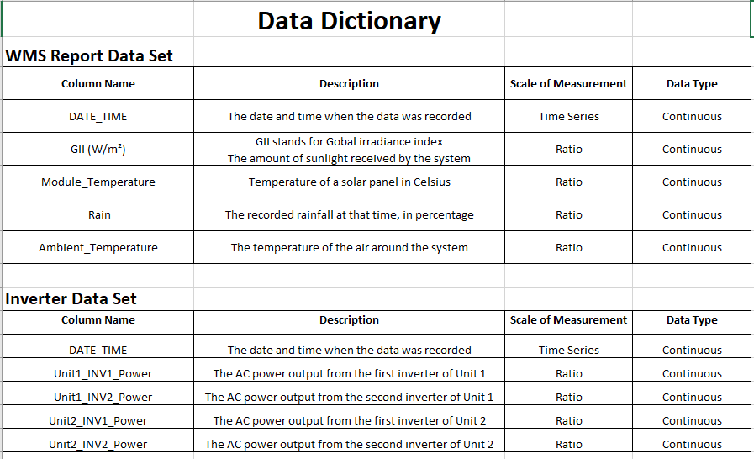
Data Dictionary

Slide 5
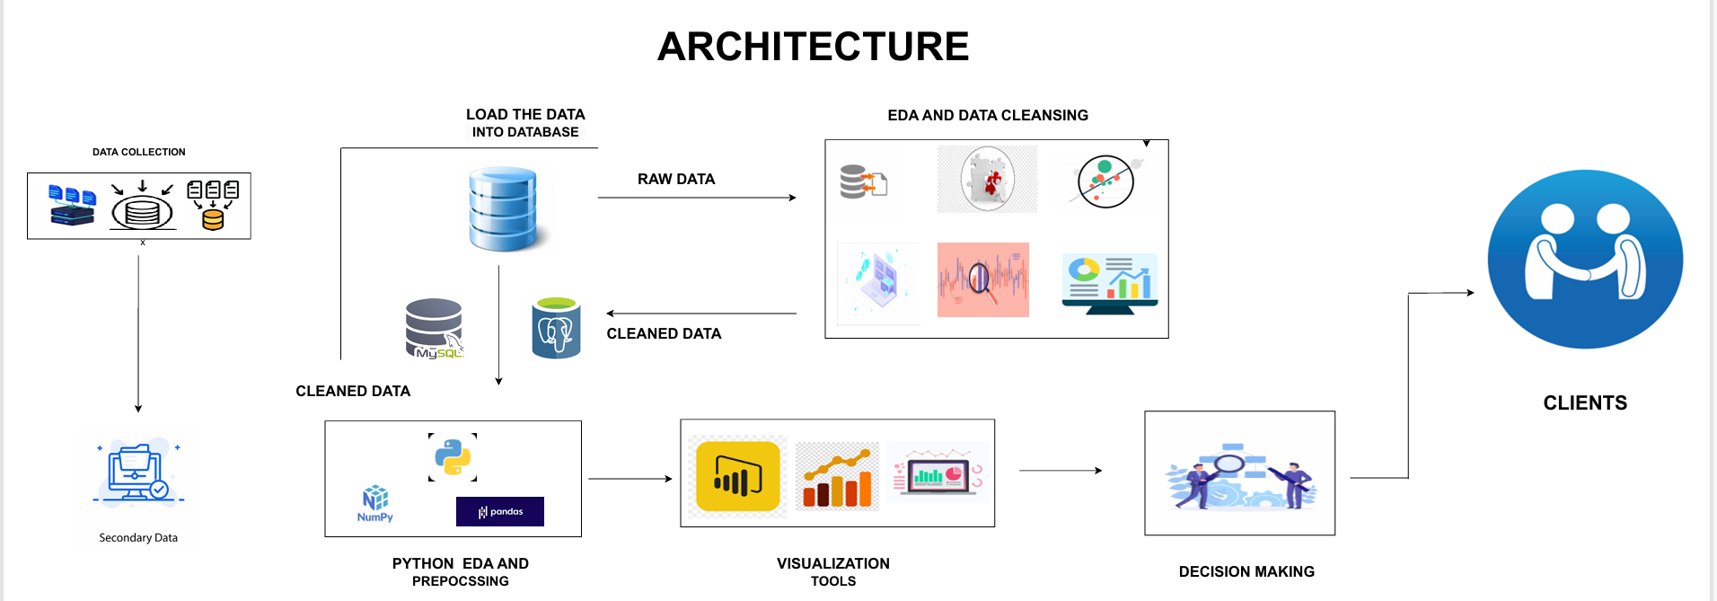

Slide 6
Project Overview
Optimized solar power generation by analyzing inverter performance and weather data.
Identified how irradiance, temperature, and rain affect energy output and efficiency.
Scope
Data Integration: Merged inverter (Watts) and weather data — irradiance (W/m²), temperature (°C), and rain.
Data Preprocessing: Cleaned, formatted, and standardized timestamps for accurate analysis.
EDA (Python): Explored trends and correlations between weather and power output.
SQL Analysis: Calculated average inverter output, irradiance levels, and profit per kWh.
Power BI Visualization: Built dashboards for generation trends, efficiency, and weather impact.
Business Impact: Improved energy efficiency, reduced losses, and projected 30% revenue growth.

Slide 7
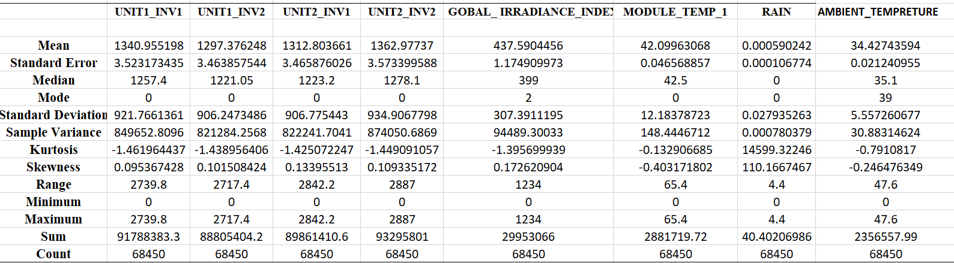
Exploratory Data Analysis [EDA]

Slide 8
Data Preprocessing
Data Cleaning – Removed unwanted rows, renamed columns, and trimmed spaces.
Data Type Conversion – Converted date and inverter readings to proper formats.
Data Integration (Merging) – Combined Inverter and WMS datasets on Date Time.
Data Transformation – Standardized date-time and rounded numeric values.
Data Quality Check – Checked for duplicates and missing values before export.

Slide 9
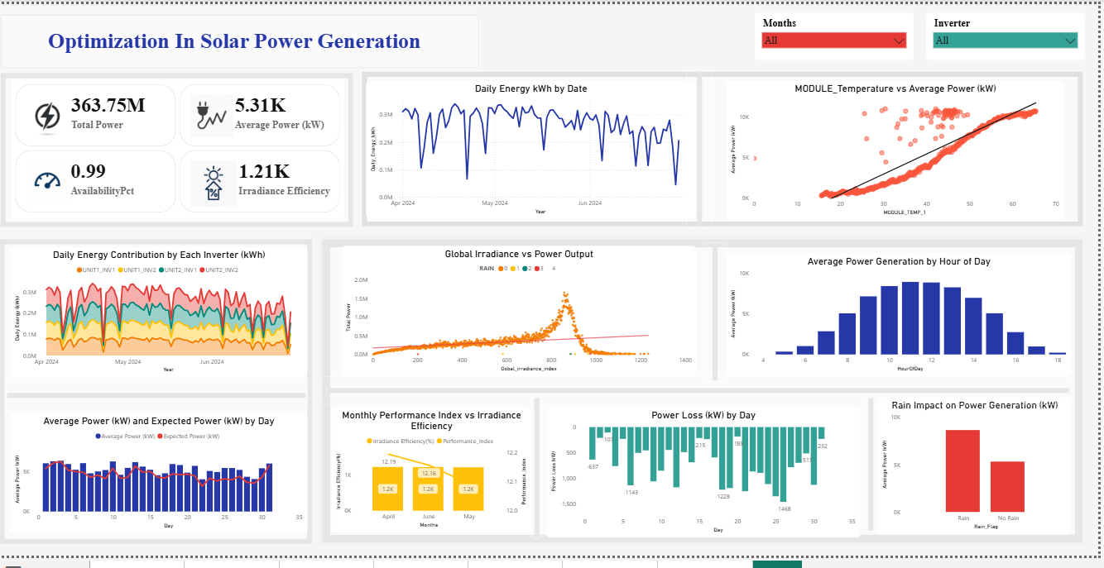
Data Visualization

Slide 10
Solution
Plan operations on cloudy days using irradiance and weather data to reduce power fluctuations.
Schedule maintenance low-generation hours (early morning or evening) to avoid production loss.
Enhance panel cooling with better ventilation or reflective coatings to maintain efficiency.
Ensure regular panel cleaning to prevent dust buildup and sustain steady output.
Monitor real-time performance in Power BI and act quickly on low-output alerts.
Implement energy storage systems to save excess power for rainy or low-sun periods.

